Slide 1
Module – 2
CHAPTER 2
Understanding Data

Slide 2
2.1 WHAT IS DATA?
All facts are data.
In computer systems, bits encode facts present in numbers, text, images, audio, and video.
Data can be directly human interpretable (such as numbers or texts) or diffused data such as images or video that can be interpreted only by a computer.
Today, business organizations are accumulating vast and growing amounts of data of the order of gigabytes, tera bytes, exabytes. A byte is 8 bits.
A bit is either 0 or 1. A kilo byte (KB) is 1024 bytes, one mega byte (MB) is approximately 1000 KB, one giga byte is approximately 1,000,000 KB, 1000 giga bytes is one tera byte and 1000000 tera bytes is one Exa byte.

Slide 3
Data is available in different data sources like flat files, databases, or data warehouses.
It can either be an operational data or a non-operational data.
Operational data is the one that is encountered in normal business procedures and processes.
For example: Daily sales data is operational data
Non-operational data is the kind of data that is used for decision making.
Operational data - It is the real-time business information, Eg: transactions and financial operations
Non-operational data in the operation, maintenance and management of substation equipment.
Non-operational data - Ex: Administrative data

Slide 4
Data by itself is meaningless.
It has to be processed to generate any information.
A string of bytes is meaningless. Only when a label is attached like height of students of a class, the data becomes meaningful.
Processed data is called information that includes patterns, associations, or relationships among data.
For example, sales data can be analyzed to extract information like which product was sold larger in the last quarter of the year.

Slide 5
Elements of Big Data
Data whose volume is less and can be stored and processed by a small-scale computer is called ‘small data’.
These data are collected from several sources, and integrated and processed by a small-scale computer.
Big data, on the other hand, is a larger data whose volume is much larger than ‘small data’ and is characterized as follows:
6V’s of Big Data:
Volume
Velocity
Variety
Veracity
Validity
Value

Slide 6
Volume – Since there is a reduction in the cost of storing devices, there has been a tremendous growth of data.
Small traditional data is measured in terms of gigabytes (GB) and terabytes (TB),
Big Data is measured in terms of petabytes (PB)(one petabyte is 1,024 terabytes) and exabytes (EB). One exabyte is 1 million terabytes.

Slide 7
2. Velocity – The fast arrival speed of data and its increase in data volume is noted as velocity.
The availability of IoT devices and Internet power ensures that the data is arriving at a faster rate.
Velocity helps to understand the relative growth of big data and its accessibility by users, systems, and applications.
Velocity is the measure of how fast the data is coming in.

Slide 8
3. Variety :
The variety of Big Data includes:
• Form – There are many forms of data. Data types range from text, graph, audio, video, to maps.
There can be composite data too, where one media can have many other sources of data, for example, a video can have an audio song.
•Function – These are data from various sources like human conversations, transaction records, and old archive data.
• Source of data – This is the third aspect of variety. There are many sources of data. The data source can be classified as open/public data, social media data and multimodal data.

Slide 9
4.Veracity of data :
Veracity of data deals with aspects like conformity to the facts, truthfulness, believability, and confidence in data.
There may be many sources of error such as technical errors, typographical errors, and human errors.
So, veracity is one of the most important aspects of data.

Slide 10
5. Validity :
Validity is the accuracy of the data for taking decisions or for any other goals that are needed by the given problem.
6. Value :
Value is the characteristic of big data that indicates the value of the information that is extracted from the data and its influence on the decisions that are taken based on it.
Data validity refers to the degree to which business rules or definitions are accurately represented
Value of data refers to the benefits and advantages that organizations can derive from their data assets, such as innovations, services, security measures, improved decision-making, better customer experiences

Slide 11
The data quality of the numeric attributes is determined by factors like precision, bias, and accuracy.
Precision is defined as the closeness of repeated measurements.
Often, standard deviation is used to measure the precision.
Bias is a systematic result due to erroneous assumptions of the algorithms or procedures.
Accuracy is the degree of measurement of errors that refers to the closeness of measurements to the true value of the quantity.
Normally, the significant digits used to store and manipulate indicate the accuracy of the measurement.
Precision refers to the closeness of two or more measurements to each other. Using the example above, if you weigh a given substance five times, and get 1.2 kg each time, then your measurement is very precise. Precision is independent of accuracy. You can be very precise but inaccurate

Slide 12
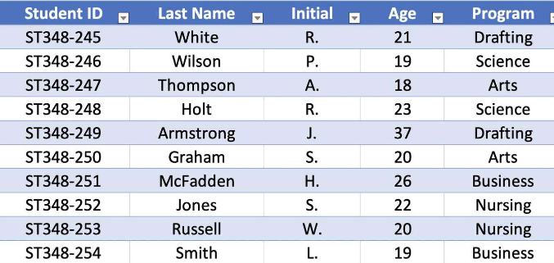
2.1.1 Types of Data
In Big Data, there are three kinds of data.
They are structured data, unstructured data,
and semi-structured data.
Structured Data
In structured data, data is stored in an organized manner such as a database where it is available in the form of a table. The data can also be retrieved in an organized manner using tools like SQL.
The structured data frequently encountered in machine learning are listed below:
Record Data
A dataset is a collection of measurements taken from a process. We have a collection of objects in a dataset and each object has a set of measurements.

Slide 13
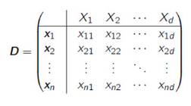
The measurements can be arranged in the form of a matrix.
Rows in the matrix represent an object and can be called as entities, cases, or records.
The columns of the dataset are called attributes, features, or fields. The table is filled with observed data. Also, it is better to note the general jargons that are associated with the dataset.
Label is the term that is used to describe the individual observations.
Data Matrix
It is a variation of the record type because
it consists of numeric attributes
The standard matrix operations can be applied on these data.
The data is thought of as points or vectors in the multidimensional space where every attribute is a dimension describing the object.
Jargon is occupation-specific language used by people in a given profession

Slide 14
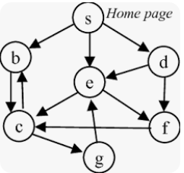
Graph Data
It involves the relationships among objects.
For example, a web page can refer to another web page. This can be modeled as a graph. The modes are web pages and the hyperlink is an edge that connects the nodes.

Slide 15
Ordered Data
Ordered data objects involve attributes that have an implicit order among them. The examples of ordered data are:
Temporal data – It is the data whose attributes are associated with time.
For example, the customer purchasing patterns during festival time is sequential data.
Time series data is a special type of sequence data where the data is a series of measurements over time.
Temporal refers to time. Example : Moving objects, such as trains; or repeated observations, such as counts from traffic sensors.

Slide 16
Sequence data – It is like sequential data but does not have time stamps.
This data involves the sequence of words or letters. For example, DNA data is a sequence of four characters – A T G C.
Spatial data – It has attributes such as positions or areas. For example, maps are spatial data where the points are related by location.
Sequence data : Data in which the points in the dataset are depend on the other points in the dataset.
Eg: DNA, protein, customer purchase history, web surfing history etc
Spatial data : Spatial refers to space.
Spatial data is any type of data that directly or indirectly references a specific geographical area or location.
Spatial data can have any number of attributes about a location. For example, this may be a map, photographs, historical information.
Example for temporal and spatial data : shipping movements across a geographic area over time.

Slide 17
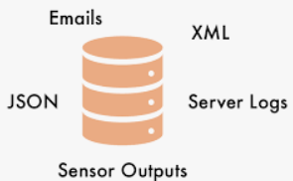
Unstructured Data
Unstructured data includes video, image, and audio. It also includes textual documents, programs, and blog data.
It is estimated that 80% of the data are unstructured data.
Semi-Structured Data
Semi-structured data are partially structured and partially unstructured. These include data like XML/JSON data, RSS feeds, and hierarchical data.

Slide 18
2.1.2 Data Storage and Representation
Once the dataset is assembled, it must be stored in a structure that is suitable for data analysis.
The goal of data storage management is to make data available for analysis.
There are different approaches to organize and manage data in storage files and systems from flat file to data warehouses.

Slide 19
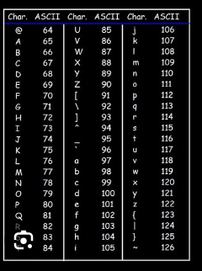
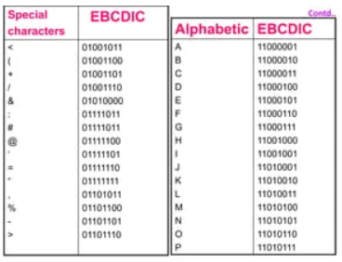
Flat Files
These are the simplest and most commonly available data source. It is also the cheapest way of organizing the data. These flat files are the files where data is stored in plain ASCII or EBCDIC format. (Extended binary coded decimal interchange code)
Minor changes of data in flat files affect the results of the data mining algorithms. Hence, flat file is suitable only for storing small dataset and not desirable if the dataset becomes larger.

Slide 20
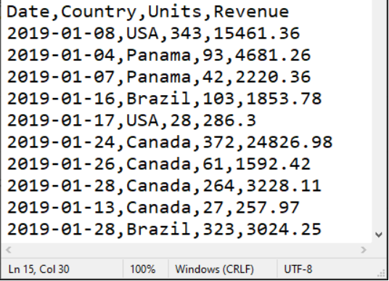
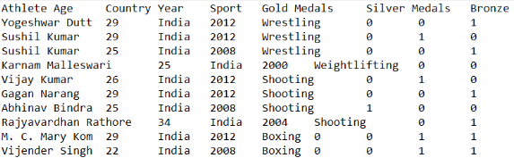
Some of the popular spreadsheet formats are listed below:
• CSV files – CSV stands for comma-separated value files where the values are separated by commas.
These are used by spreadsheet and database applications. The first row may have attributes and the rest of the rows represent the data.
• TSV files – TSV stands for Tab separated values files where values are separated by Tab.
Both CSV and TSV files are generic in nature and can be shared. There are many tools like Google Sheets and Microsoft Excel to process these files.

Slide 21
Database System
It normally consists of database files and a database management system (DBMS).
Database files contain original data and metadata.
DBMS aims to manage data and improve operator performance by including various tools like database administrator, query processing, and transaction manager.
The DBA is responsible for managing and maintaining the database system. This includes tasks such as database design, security, performance tuning etc
DBMS supports a query language (e.g., SQL) that allows users to retrieve and manipulate data
Transactions are sequences of one or more database operations that are treated as a single unit of work. The transaction manager ensures the ACID properties (Atomicity, Consistency, Isolation, Durability) of transactions.

Slide 22
A relational database consists of sets of tables.
The tables have rows and columns.
The columns represent the attributes and rows represent tuples.
A tuple corresponds to either an object or a relationship between objects.
A user can access and manipulate the data in the database using SQL.
Relational database – to link and relate data across multiple tables through defined relationships.
Example: Student table, Department table.

Slide 23
Different types of databases are listed below:
Transactional database
A transactional database is a collection of transactional records.
Each record is a transaction.
A transaction may have a time stamp, identifier and a set of items, which may have links to other tables.
Normally, transactional databases are created for performing associational analysis that indicates the correlation among the items.
Transactional database:
Example is banking where you want a whole transaction—debit from one account and credit to another—to either succeed or fail), sales order entry, hotel reservation systems etc
Transactional databases store data in rows rather than columns to read and write data quickly

Slide 24
2. Time-series database
It stores time related information like log files where data is associated with a time stamp.
This data represents the sequences of data, which represent values or events obtained over a period (for example, hourly, weekly or yearly) or repeated time span.
Observing sales of product continuously may yield a time-series data.
Time-series data is a sequence of data points collected over time intervals, allowing us to track changes over time
Eg: sensor data, Recording stock prices over time.

Slide 25
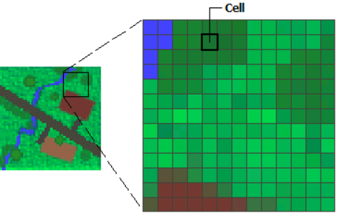
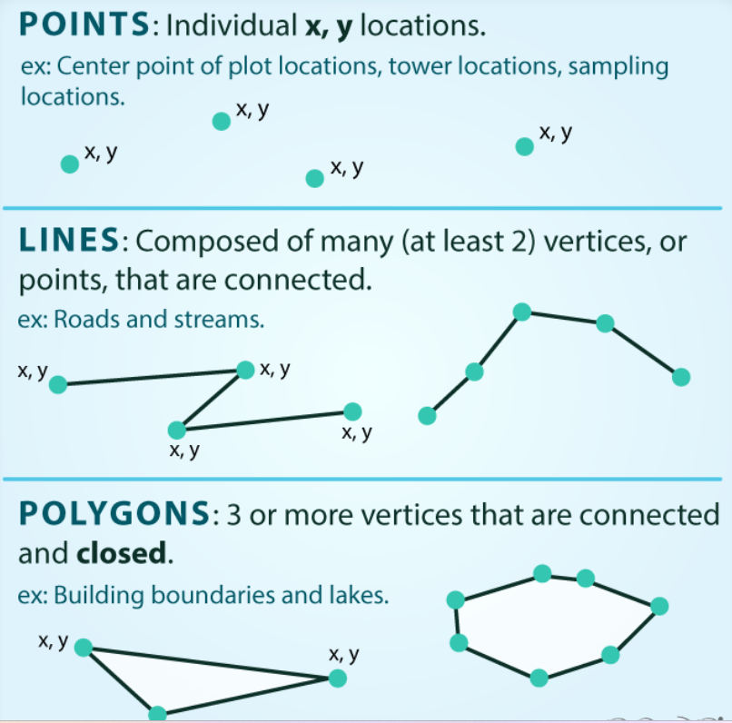
3. Spatial databases:
It contain spatial information in a raster or vector format. Raster formats are either bitmaps or pixel maps.
For example, images can be stored as a raster data.
On the other hand, the vector format can be used to store maps as maps use basic geometric primitives like points, lines, polygons and so forth.
World Wide Web (WWW)
It provides a diverse, worldwide online information source. The objective of data mining algorithms is to mine interesting patterns of information present in WWW.
Raster files work best when you need to store and display high-quality photographs

Slide 26
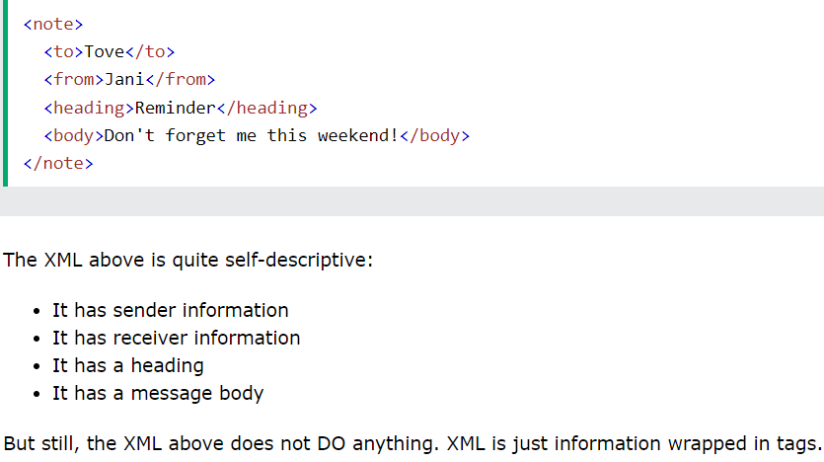
XML (eXtensible Markup Language)
It is both human and machine interpretable data format that can be used to represent data that needs to be shared across the platforms.

Slide 27
Data Stream
It is dynamic data, which flows in and out of the observing environment. Typical characteristics of data stream are huge volume of data, dynamic, fixed order movement, and real-time constraints.
RSS (Really Simple Syndication) - such as blog entries, news headlines etc
It is a format for sharing instant feeds across services.
JSON (JavaScript Object Notation)
It is another useful data interchange format that is often used for many machine learning algorithms.
JSON (JavaScript Object Notation) is a text-based, human-readable data interchange format used to exchange data between web clients and web servers
Data streams capture critical real-time data, such as location, stock prices, IT system monitoring, fraud detection, retail inventory, sales, and customer activity.

Slide 28
2.2 BIG DATA ANALYTICS AND TYPES OF ANALYTICS
The primary aim of data analysis is to assist business organizations to take decisions.
For example, a business organization may want to know which is the fastest selling product, in order for them to market activities.
Data analysis is an activity that takes the data and generates useful information and insights for assisting the organizations.
Data analysis and data analytics are terms that are used interchangeably to refer to the same concept. However, there is a subtle difference.
Data analytics is a general term and data analysis is a part of it.
Data analytics refers to the process of data collection, preprocessing and analysis. It deals with the complete cycle of data management.
Data analysis is just analysis and is a part of data analytics. It takes historical data and does the analysis.

Slide 29
It takes historical data and does the analysis.
Data analytics, instead, concentrates more on future and helps in prediction.
There are four types of data analytics:
1. Descriptive analytics
2. Diagnostic analytics
3. Predictive analytics
4. Prescriptive analytics

Slide 30
Descriptive Analytics
It is about describing the main features of the data.
After data collection is done, descriptive analytics deals with the collected data and quantifies it.
It is often stated that analytics is essentially statistics.
There are two aspects of statistics – Descriptive and Inference. Descriptive analytics only focuses on the description part of the data and not the inference part.
What was our overall productivity?
Descriptive Analytics tells you what happened in the past.
Diagnostic Analytics helps you understand why something happened in the past.
Predictive Analytics predicts what is most likely to happen in the future.
Prescriptive Analytics recommends actions you can take to affect those outcomes.

Slide 31
Diagnostic Analytics
It deals with the question – ‘Why?’. This is also known as causal analysis, as it aims to find out the cause and effect of the events.
For example, if a product is not selling, diagnostic analytics aims to find out the reason. There may be multiple reasons and associated effects are analyzed as part of it.
Why did our company sales decrease in the previous quarter?
Descriptive Analytics tells you what happened in the past.
Diagnostic Analytics helps you understand why something happened in the past.
Predictive Analytics predicts what is most likely to happen in the future.
Prescriptive Analytics recommends actions you can take to affect those outcomes.

Slide 32
Predictive Analytics
It deals with the future. It deals with the question – ‘What will happen in future given this data?’.
This involves the application of algorithms to identify the patterns to predict the future.
The entire course of machine learning is mostly about predictive analytics and forms the core of this book.
Predicting maintenance issues, Predicting article popularity
Descriptive Analytics tells you what happened in the past.
Diagnostic Analytics helps you understand why something happened in the past.
Predictive Analytics predicts what is most likely to happen in the future.
Prescriptive Analytics recommends actions you can take to affect those outcomes.

Slide 33
Prescriptive Analytics
It is about the finding the best course of action for the business organizations.
Prescriptive analytics goes beyond prediction and helps in decision making by giving a set of actions.
It helps the organizations to plan better for the future and to mitigate the risks that are involved.
Automatic adjustment of product pricing based on customer demand and external factors.
Descriptive Analytics tells you what happened in the past.
Diagnostic Analytics helps you understand why something happened in the past.
Predictive Analytics predicts what is most likely to happen in the future.
Prescriptive Analytics recommends actions you can take to affect those outcomes.

Slide 34
BIG DATA ANALYSIS FRAMEWORK
For performing data analytics, many frameworks are proposed.
All proposed analytics frameworks have some common factors.
Big data framework is a layered architecture.
Such an architecture has many advantages such as genericness.
A 4-layer architecture has the following layers:
1. Data connection layer
2. Data management layer
3. Data analytics later
4. Presentation layer

Slide 35
Data Connection Layer
It has data ingestion mechanisms and data connectors.
Data ingestion means taking raw data and importing it into appropriate data structures.
It performs the tasks of ETL process. By ETL, it means extract, transform and load operations
The data link layer is the protocol layer in a program that handles how data moves in and out of a physical link in a network.

Slide 36
Data Management Layer
It performs preprocessing of data.
The purpose of this layer is to allow parallel execution of queries, and read, write and data management tasks.
There may be many schemes that can be implemented by this layer such as data-in-place, where the data is not moved at all, or constructing data repositories such as data warehouses and pull data on-demand mechanisms.
Data management is the process of ingesting(from multiple sources into a single), storing, organizing and maintaining the data created and collected by an organization.

Slide 37
Data Analytic Layer
It has many functionalities such as statistical tests, machine learning algorithms to understand, and construction of machine learning models.
This layer implements many model validation mechanisms too. The processing is done as shown below
Cloud Computing Cloud computing is an emerging technology which is basically a business service model or simply called as pay-per-usage model.
The term ‘Cloud’ refers to the Internet that provides sharing of processing power, applications, storage and services.

Slide 38
It offers different kinds of services such as Iaas, Paas, and SaaS.
SaaS (Software as a Service) enables users to access software applications from the cloud. (Email, Microsoft office 365)
Paas (Platform as a Service) provides users the platform to develop and run their applications. (Google App Engine is a cloud computing platform as a service for developing and hosting web applications)
Iaas (Infrastructure as a Service) enables users to access the infrastructure required to run their applications, storage, operating systems, servers etc.

Slide 39
The Public Cloud is accessible to the public and is owned by a vendor, who offers the services of the cloud to the users.
Private Cloud is a privately-owned cloud where the user or an organization owns the cloud and only the user or employees of that organization have access to the cloud, thereby making data and transactions secure.
In Community Cloud, the infrastructure is owned jointly by different organizations.
The Hybrid Cloud is the combination of two or more cloud types.

Slide 40
The characteristics of cloud computing are:
1. Shared Infrastructure – Sharing of physical services, storage, and networking capabilities
2. Dynamic Provisioning – Resources assigned dynamically, based on demands
3. Dynamic Scaling – Expansion and contraction of service capability
4. Network Access – Needs to be accessed across the internet
5. Utility-based Metering – Uses metering to provide reporting and billing information
6. Multitenancy – Serves multiple customers
7. Reliability – Customer reliable service
Metered billing is a pricing model in which you pay for a service only based on the level of usage. For example, the cost of a service might depend on time used, volume of data processed, or CPU cycles — depending on the type of service. You receive a monthly bill to pay for your actual level of usage and nothing more.

Slide 41
Grid Computing Grid Computing is a parallel and distributed computing framework consisting of a network of computers offering a super computing service as a single virtual supercomputer.
This high-performance computing is required to perform specialized tasks that require a high computing power and a single computer cannot provide enough computing resources.
H-Computing (High Performance Computing or HPC) It enables to perform complex tasks at high speed.
It aggregates computing power in such a way that provides much higher performance to solve complex problems in science, engineering, research or business. It leverages parallel processing techniques for solving complex computational problems.

Slide 42
Presentation Layer It has mechanisms such as dashboards, and applications that display the results of analytical engines and machine learning algorithms.
Thus, the Big Data processing cycle involves data management that consists of the following steps.
1. Data collection
2. Data preprocessing
3. Applications of machine learning algorithm
4. Interpretation of results and visualization of machine learning algorithm
This is an iterative process and is carried out on a permanent basis to ensure that data is suitable for data mining.

Slide 43
2.3.1 Data Collection
The first task of gathering datasets are the collection of data. It is often estimated that most of the time is spent for collection of good quality data.
A good quality data yields a better result. It is often difficult to characterize a ‘Good data’.
‘Good data’ is one that has the following properties:
1. Timeliness – The data should be relevant and not stale or obsolete data.
2. Relevancy – The data should be relevant and ready for the machine learning or data mining algorithms. All the necessary information should be available and there should be no bias in the data.
3. Knowledge about the data – The data should be understandable and interpretable, and should be self-sufficient for the required application as desired by the domain knowledge engineer.
Obsolete data is outdated information that is no longer used by the organization. Stale data- no longer new or fresh, usually as a result of being kept for too long.

Slide 44
The data source can be classified as open/public data, social media data and multimodal data.
Open or public data source – It is a data source that does not have any stringent copyright rules or restrictions.
Its data can be primarily used for many purposes.
Government census data are good examples of open data:
• Digital libraries that have huge amount of text data as well as document images
• Scientific domains with a huge collection of experimental data like genomic data and biological data
• Healthcare systems that use extensive databases like patient databases, health insurance data, doctors’ information, and bioinformatics information

Slide 45
2. Social media – It is the data that is generated by various social media platforms like Twitter, Facebook, YouTube, and Instagram.
An enormous amount of data is generated by these platforms.
3. Multimodal data – It includes data that involves many modes such as text, video, audio and mixed types.
Some of them are listed below:
• Image archives contain larger image databases along with numeric and text data
• The World Wide Web (WWW) has huge amount of data that is distributed on the Internet.

Slide 46
2.3.2 Data Preprocessing
In real world, the available data is ’dirty’. By this word ’dirty’, it means:
• Incomplete data
• Inaccurate data
• Outlier data
• Data with missing values
• Data with inconsistent values
• Duplicate data

Slide 47
Data preprocessing improves the quality of the data mining techniques. The raw data must be preprocessed to give accurate results.
The process of detection and removal of errors in data is called data cleaning.
Data wrangling means making the data processable for machine learning algorithms.
Some of the data errors include human errors such as typographical errors or incorrect measurement and structural errors like improper data formats.
Data wrangling is the process of transforming and structuring data from one raw form into a desired format

Slide 48
Data errors can also arise from omission and duplication of attributes.
Noise is a random component and involves distortion of a value or introduction of spurious objects.
Often, the noise is used if the data is a spatial or temporal component.
Certain deterministic distortions in the form of a streak are known as artifacts.

Slide 49
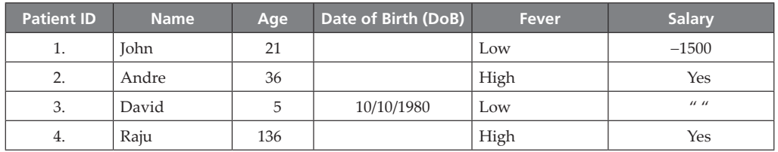
Consider, for example, the following patient Table. The ‘bad’ or ‘dirty’ data can be observed in this table.
It can be observed that data like Salary = “ “ is incomplete data.
The DoB of patients, John, Andre, and Raju, is the missing data.
The age of David is recorded as ‘5’ but his DoB indicates it is 10/10/1980. This is called inconsistent data.
Inconsistent data occurs due to problems in conversions, inconsistent formats, and difference in units. Salary for John is -1500. It cannot be less than ‘0’.

Slide 50
Outliers are data that exhibit the characteristics that are different from other data and have very unusual values.
The age of Raju cannot be 136. It might be a typographical error. It is often required to distinguish between noise and outlier data.
Outliers may be legitimate data and sometimes are of interest to the data mining algorithms.
These errors often come during data collection stage. These must be removed so that machine learning algorithms yield better results as the quality of results is determined by the quality of input data. This removal process is called data cleaning.

Slide 51
Missing Data Analysis
.
The primary data cleaning process is missing data analysis.
Data cleaning routines attempt to fill up the missing values, smoothen the noise while identifying the outliers and correct the inconsistencies of the data.
This enables data mining to avoid overfitting of the models. The procedures that are given below can solve the problem of missing data:
1. Ignore the tuple – A tuple with missing data, especially the class label, is ignored. This method is not effective when the percentage of the missing values increases.
2. Fill in the values manually – Here, the domain expert can analyse the data tables and carry out the analysis and fill in the values manually. But, this is time consuming and may not be feasible for larger sets.

Slide 52
3. A global constant can be used to fill in the missing attributes. The missing values may be ’Unknown’ or be ’Infinity’.
4. The attribute value may be filled by the attribute value. Say, the average income can replace a missing value.
5. Use the attribute mean for all samples belonging to the same class. Here, the average value replaces the missing values of all tuples that fall in this group.
6. Use the most possible value to fill in the missing value. The most probable value can be obtained from other methods like classification and decision tree prediction.
The difference between the estimated and the original value is called an error or bias.

Slide 53
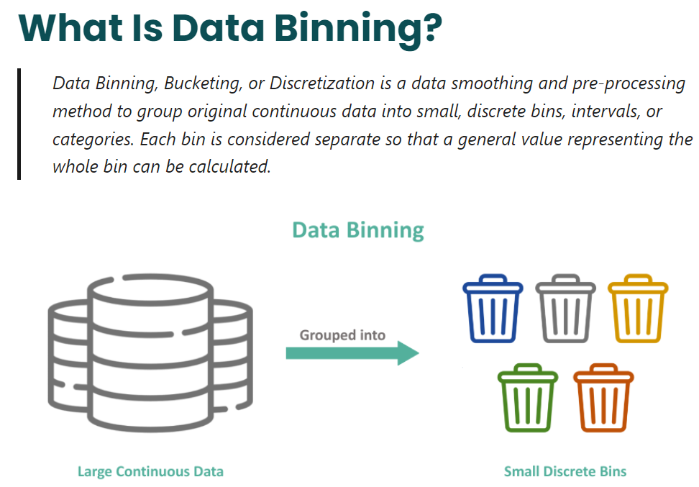
Removal of Noisy or Outlier Data
Noise is a random error or variance in a measured value.
It can be removed by using binning, which is a method where the given data values are sorted and distributed into equal frequency bins. The bins are also called as buckets.
The binning method then uses the neighbor values to smooth the noisy data.
Data smoothing is data pre-processing technique used to remove the noise from the dataset

Slide 54
Some of the techniques commonly used are
‘smoothing by means’ where the mean of the bin removes the values of the bins,
‘smoothing by bin medians’ where the bin median replaces the bin values, and
‘smoothing by bin boundaries’ where the bin value is replaced by the closest bin boundary. The maximum and minimum values are called bin boundaries.
Binning methods may be used as a discretization technique or bucketing.
It involves dividing a continuous variable into a set of smaller intervals or bins and replacing the original values with the corresponding bin labels.

Slide 55
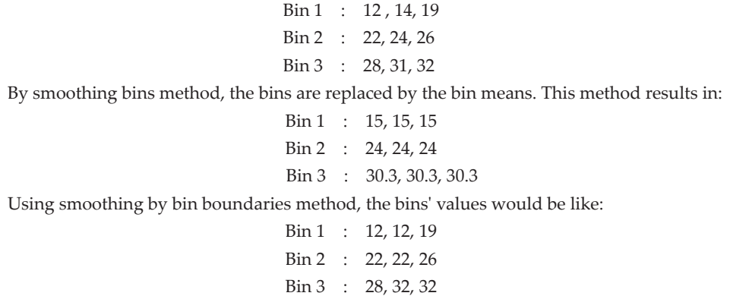
2.1: Consider the following set: S = {12, 14, 19, 22, 24, 26, 28, 31, 34}. Apply various binning techniques and show the result.
Solution: By equal-frequency bin method, the data should be distributed across bins.
Let us assume the bins of size 3, then the above data is distributed across the bins as shown below:
As per the method, the minimum and maximum values of the bin are determined, and it serves as bin boundary and does not change.
Rest of the values are transformed to the nearest value.
It can be observed in Bin 1, the middle value 14 is compared with the boundary values 12 and 19 and changed to the closest value, that is 12.
This process is repeated for all bins.

Slide 56
Data Integration and Data Transformations
Data integration involves routines that merge data from multiple sources into a single data source.
So, this may lead to redundant data. The main goal of data integration is to detect and remove redundancies that arise from integration.
Data transformation routines perform operations like normalization to improve the performance of the data mining algorithms.
It is necessary to transform data so that it can be processed.
This can be considered as a preliminary stage of data conditioning. Normalization is one such technique.

Slide 57
In normalization, the attribute values are scaled to fit in a range (say 0-1) to improve the performance of the data mining algorithm.
Often, in neural networks, these techniques are used.
Some of the normalization procedures used are:
1. Min-Max
2. z-Score
Normalization is a technique often applied as part of data preparation for machine learning.
The goal of normalization is to change the values of numeric columns in the dataset to use a common scale, without distorting differences in the ranges of values or losing information

Slide 58

Min-Max Procedure
It is a normalization technique where each variable V is normalized by its difference with the minimum value divided by the range to a new range, say 0–1.
Often, neural networks require this kind of normalization.
The formula to implement this normalization is given as:
Here max-min is the range. Min and max are the minimum and maximum of the given data, new max and new min are the minimum and maximum of the target range, say 0 and 1.

Slide 59
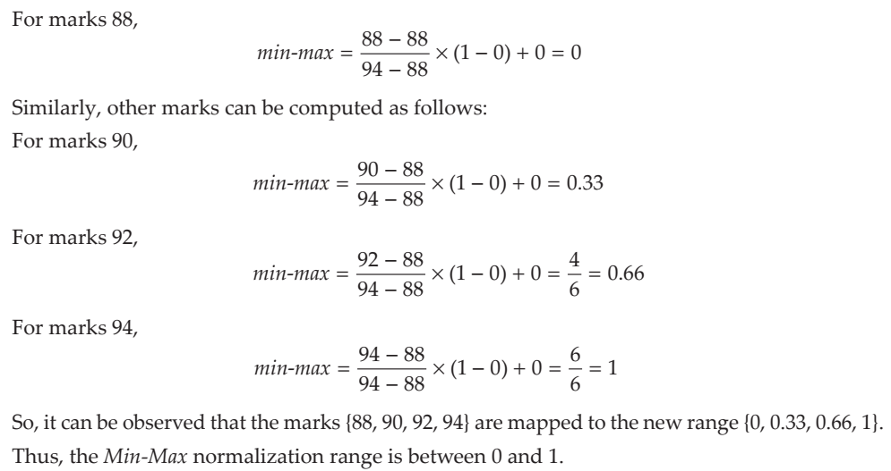
Consider the set: V = {88, 90, 92, 94}. Apply Min-Max procedure and map the marks to a new range 0–1.
Solution: The minimum of the list V is 88 and maximum is 94.
The new min and new max are 0 and 1, respectively.

Slide 60

z-Score Normalization
This procedure works by taking the difference between the field value and mean value, and by scaling this difference by standard deviation of the attribute.
Here, s is the standard deviation of the list V and m is the mean of the list V.

Slide 61
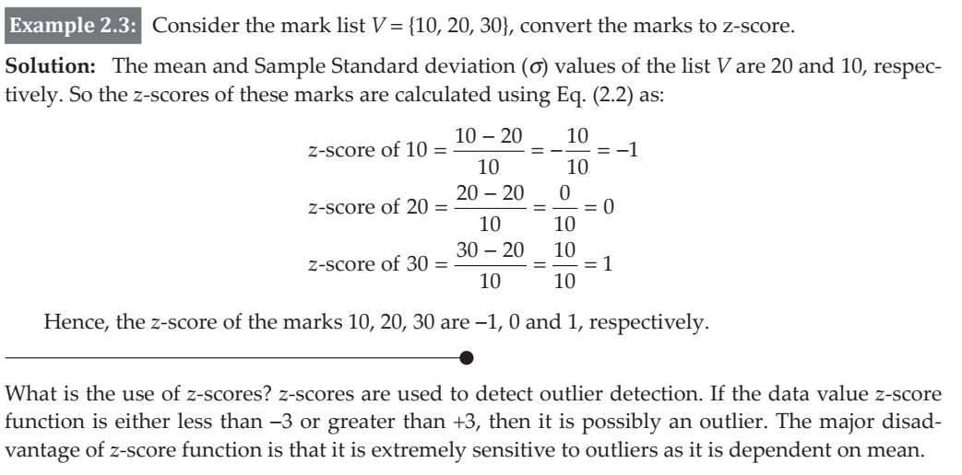

Slide 62
Data Reduction
Data reduction reduces data size but produces the same results.
There are different ways in which data reduction can be carried out such as data aggregation, feature selection, and dimensionality reduction.

Slide 63
2.4 DESCRIPTIVE STATISTICS
.
Descriptive statistics is a branch of statistics that does dataset summarization.
It is used to summarize and describe data. Descriptive statistics are just descriptive and do not go beyond that.
In other words, descriptive statistics do not bother too much about machine learning algorithms and its functioning.
Data visualization is a branch of study that is useful for investigating the given data. Mainly, the plots are useful to explain and present data to customers.

Slide 64
Descriptive analytics and data visualization techniques help to understand the nature of the data, which further helps to determine the kinds of machine learning or data mining tasks that can be applied to the data.
This step is often known as Exploratory Data Analysis (EDA).
The focus of EDA is to understand the given data and to prepare it for machine learning algorithms.
EDA includes descriptive statistics and data visualization.
Exploratory data analysis (EDA) is used by data scientists to analyze and investigate data sets and summarize their main characteristics often employing data visualization methods.

Slide 65
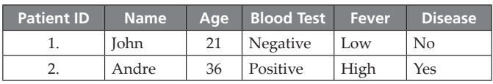
Dataset and Data Types
A dataset can be assumed to be a collection of data objects. The data objects may be records, points, vectors, patterns, events, cases, samples or observations.
These records contain many attributes. An attribute can be defined as the property or characteristics of an object.
Sample Patient Table
Every attribute should be associated with a value. This process is called measurement. The type of attribute determines the data types, often referred to as measurement scale types.

Slide 66
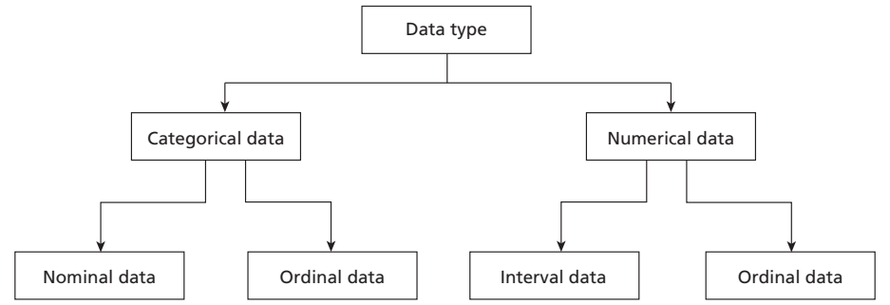
2.1: Types of Data
Broadly, data can be classified into two types:
Categorical or qualitative data
2. Numerical or quantitative data

Slide 67

For Understanding:
Categorical data represents characteristics. Therefore it can represent things like a person’s gender, language etc.
Categorical data can also take on numerical values (Example: 1 for female and 0 for male).
Note that those numbers don’t have mathematical meaning.
Nominal Data
Nominal values represent discrete units and are used to label variables, that have no quantitative value.

Slide 68
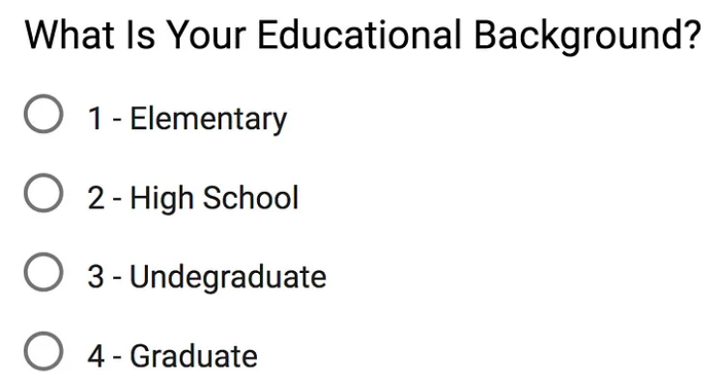
For Understanding:
Ordinal Data
Ordinal values represent discrete and ordered units. It is therefore nearly the same as nominal data, except that it’s ordering matters.

Slide 69
For Understanding:
Numerical Data:
Discrete Data
if its values are distinct and separate
if the data can only take on certain values
An example is the number of heads in 100 coin flips.
Continuous Data
It represents measurements and therefore their values can’t be counted but they can be measured. An example would be the height of a person, which you can describe by using intervals on the real number line.

Slide 70
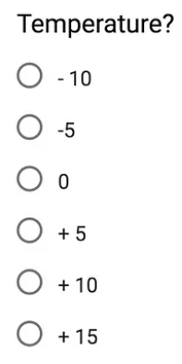
For Understanding
Interval Data
Interval values represent ordered units that have the same difference.
Ratio Data
Ratio values are also ordered units that have the same difference. Ratio values are the same as interval values, with the difference that they do have an absolute zero. Good examples are height, weight, length etc.

Slide 71
Categorical or Qualitative Data
The categorical data can be divided into two types. They are nominal type and ordinal type.
• Nominal Data – In Table, patient ID is nominal data. Nominal data are symbols and cannot be processed like a number.
For example, the average of a patient ID does not make any statistical sense.
Nominal data type provides only information but has no ordering among data.
Only operations like (=, ≠) are meaningful for these data. For example, the patient ID can be checked for equality and nothing else.

Slide 72
• Ordinal Data – It provides enough information and has natural order.
For example, Fever = {Low, Medium, High} is an ordinal data.
Certainly, low is less than medium and medium is less than high, irrespective of the value.
Any transformation can be applied to these data to get a new value.

Slide 73
Numeric or Quantitative
Data It can be divided into two categories. They are interval type and ratio type.
• Interval Data – Interval data is a numeric data for which the differences between values are meaningful.
For example, there is a difference between 30 degree and 40 degree. Only the permissible operations are + and -.
• Ratio Data – For ratio data, both differences and ratio are meaningful. The difference between the ratio and interval data is the position of zero in the scale.
For example, take the Centigrade-Fahrenheit conversion. The zeroes of both scales do not match. Hence, these are interval data.

Slide 74
Another way of classifying the data is to classify it as:
1. Discrete value data
2. Continuous data
Discrete Data This kind of data is recorded as integers.
For example, the responses of the survey can be discrete data. Employee identification number such as 10001 is discrete data.
Continuous Data It can be fitted into a range and includes decimal point. For example, age is a continuous data.
Though age appears to be discrete data, one may be 12.5 years old and it makes sense. Patient height and weight are all continuous data.

Slide 75
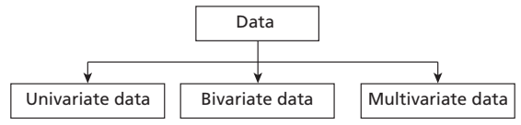
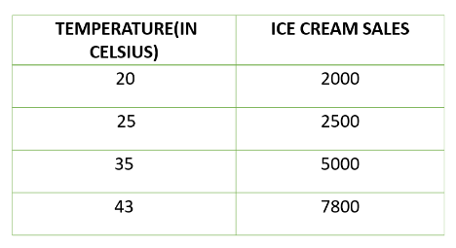
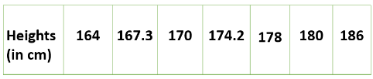
Types of Data Based on Variables
Third way of classifying the data is based on the number of variables used in the dataset.
In case of univariate data, the dataset has only one variable. A variable is also called as category.
Bivariate data indicates that the number of variables used are two and multivariate data uses three or more variables.
Bivariate data:
Univariate data :

Slide 76
2.5 UNIVARIATE DATA ANALYSIS AND VISUALIZATION
As the name indicates, the dataset has only one variable. A variable can be called as a category.
Univariate does not deal with cause or relationships.
The aim of univariate analysis is to describe data and find patterns.
Univariate data description involves finding the frequency distributions, central tendency measures, dispersion or variation, and shape of the data.

Slide 77
Data Visualization
To understand data, graph visualization is must. Data visualization helps to understand data.
It helps to present information and data to customers. Some of the graphs that are used in univariate data analysis are bar charts, histograms, frequency polygons and pie charts.
The advantages of the graphs are presentation of data, summarization of data, description of data, exploration of data, and to make comparisons of data.

Slide 78
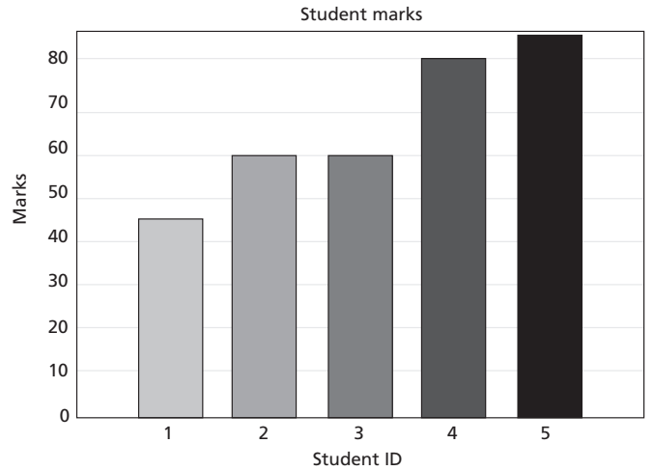
Bar Chart
A Bar chart (or Bar graph) is used to display the frequency distribution for variables.
Bar charts are used to illustrate discrete data. The charts can also help to explain the counts of nominal data. It also helps in comparing the frequency of different groups.
The bar chart for students' marks
{45, 60, 60, 80, 85}
with Student ID = {1, 2, 3, 4, 5}
is shown below in Figure

Slide 79
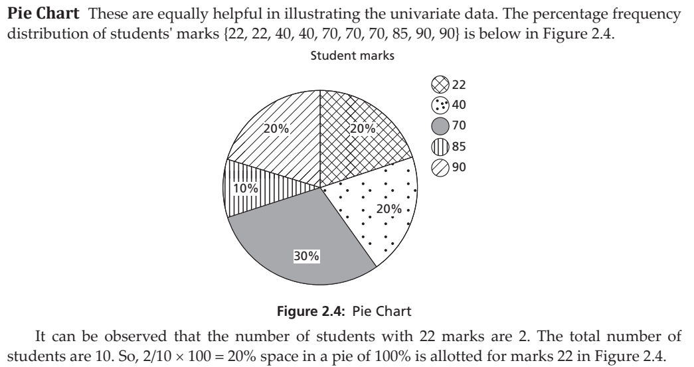

Slide 80
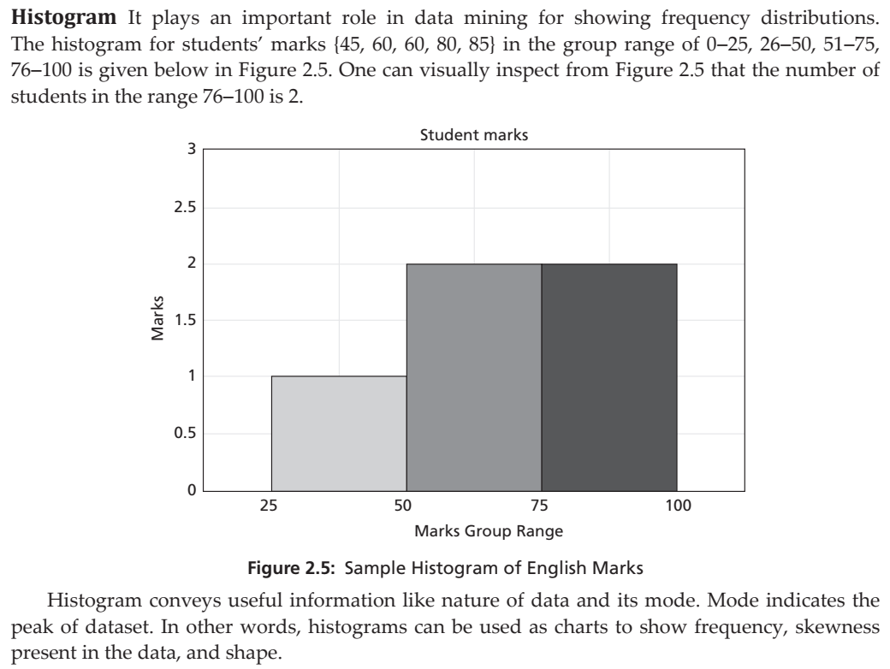

Slide 81
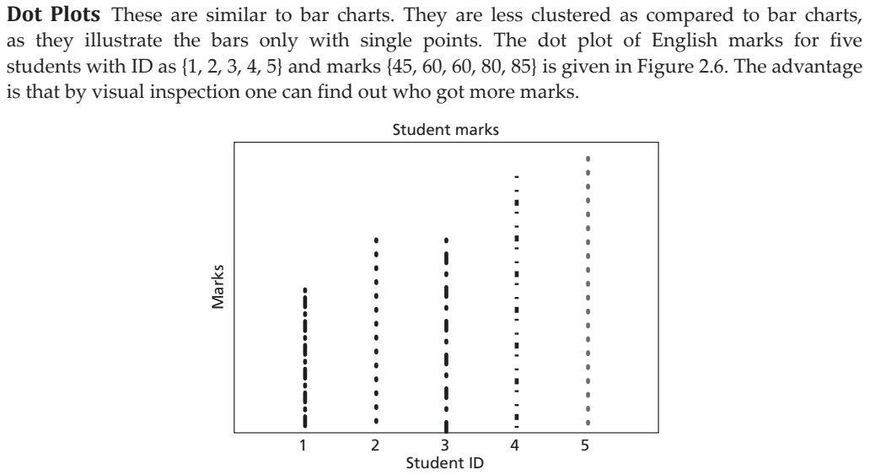
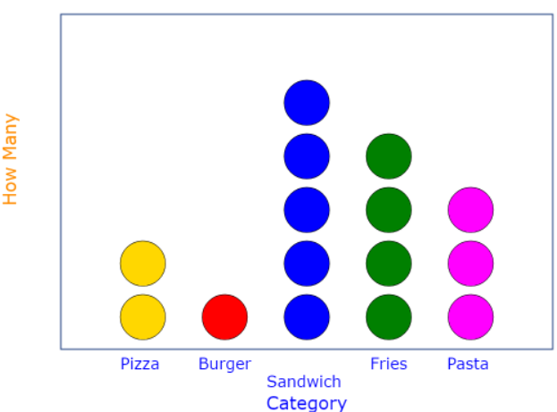

Slide 82
2.5.2 Central Tendency
One cannot remember all the data. Therefore, a condensation or summary of the data is necessary.
This makes the data analysis easy and simple. One such summary is called central tendency.
Thus, central tendency can explain the characteristics of data and that further helps in comparison.
Mass data have tendency to concentrate at certain values, normally in the central location.
It is called measure of central tendency (or averages).
This represents the first order of measures. Popular measures are mean, median and mode.

Slide 83

1. Mean – Arithmetic average (or mean) is a measure of central tendency that represents the ‘center’ of the dataset.
This is the commonest measure used in our daily conversation such as average income or average traffic.
It can be found by adding all the data and dividing the sum by the number of observations.
Mathematically, the average of all the values in the sample (population) is denoted as x.
Let x1, x2, …, xN be a set of ‘N’ values or observations, then the arithmetic mean is given as:

Slide 84
Weighted mean – Unlike arithmetic mean that gives the weightage of all items equally, weighted mean gives different importance to all items as the item importance varies.
Hence, different weightage can be given to items.
In case of frequency distribution, mid values of the range are taken for computation.
This is illustrated in the following computation.
In weighted mean, the mean is computed by adding the product of proportion and group mean. It is mostly used when the sample sizes are unequal.

Slide 85
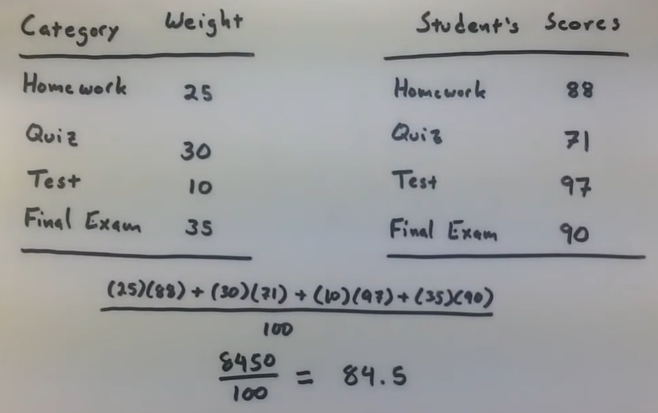
For Understanding - Weighted Mean

Slide 86

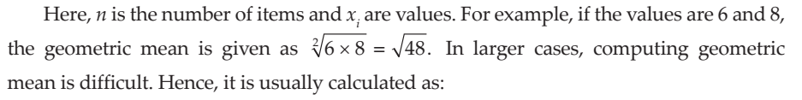
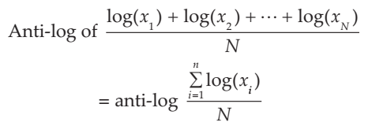
• Geometric mean – Let x1, x2, …, xN be a set of ‘N’ values or observations. Geometric mean is the Nth root of the product of N items. The formula for computing geometric mean is given as follows:
The problem of mean is its extreme sensitiveness to noise. Even small changes in the input affect the mean drastically.
Sridhar, S; Vijayalakshmi, M. Machine Learning (p. 39). Kindle Edition.

Slide 87
Median – The middle value in the distribution is called median. If the total number of items in the distribution is odd, then the middle value is called median.
If the numbers are even, then the average value of two items in the centre is the median.
It can be observed that the median is the value where xi is divided into two equal halves, with half of the values being lower than the median and half higher than the median.
A median class is that class where (N/2)th item is present.

Slide 88
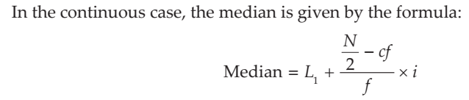
Median class is that class where N/2th item is present.
Here, i is the class interval of the median class and L1 is the lower limit of median class, f is the frequency of the median class, and cf is the cumulative frequency of all classes preceding median.

Slide 89
3. Mode – Mode is the value that occurs more frequently in the dataset. In other words, the value that has the highest frequency is called mode.
Mode is only for discrete data and is not applicable for continuous data as there are no repeated values in continuous data.
The procedure for finding the mode is to calculate the frequencies for all the values in the data, and mode is the value (or values) with the highest frequency.
Normally, the dataset is classified as unimodal, bimodal and trimodal with modes 1, 2 and 3, respectively.

Slide 90
2.5.3 Dispersion
The spreadout of a set of data around the central tendency (mean, median or mode) is called dispersion.
Dispersion is represented by various ways such as range, variance, standard deviation, and standard error. These are second order measures.
The most common measures of the dispersion data are listed below:
Range
Range is the difference between the maximum and minimum of values of the given list of data.
Standard Deviation
The mean does not convey much more than a middle point. For example, the following datasets {10, 20, 30} and {10, 50, 0} both have a mean of 20.
The difference between these two sets is the spread of data. Standard deviation is the average distance from the mean of the dataset to each point.

Slide 91
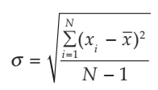
The formula for sample standard deviation is given by:
Here, N is the size of the population, xi is observation or value from the population and m is the population mean.

Slide 92
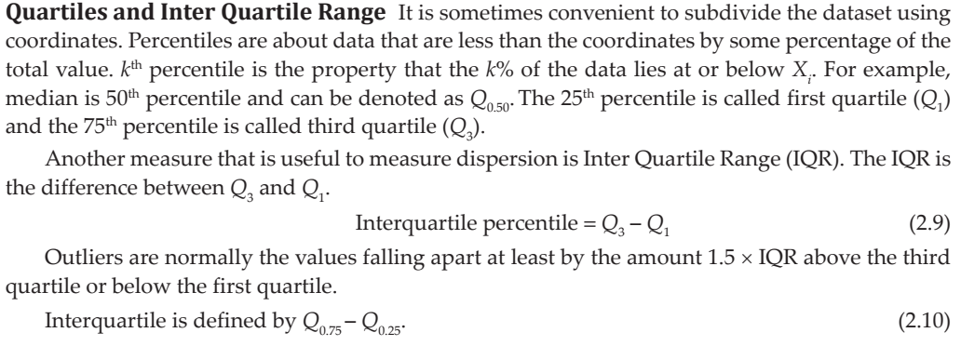

Slide 93
For patients’ age list {12, 14, 19, 22, 24, 26, 28, 31, 34}, find the IQR.
Solution: The median is in the fifth position. In this case, 24 is the median.
The first quartile is median of the scores below the mean i.e., {12, 14, 19, 22}. Hence, it’s the median of the list below 24.
In this case, the median is the average of the second and third values, that is, Q_{0.25} = 16.5.
Similarly, the third quartile is the median of the values above the median, that is {26, 28, 31, 34}.
So, Q_{0.75} is the average of the seventh and eighth score. In this case, it is 28 + 31/2 = 59/2 = 29.5. Hence, the IQR using
Eq. (2.10) is: = Q_{0.75} – Q_{0.25} = 29.5-16.5 = 13

Slide 94
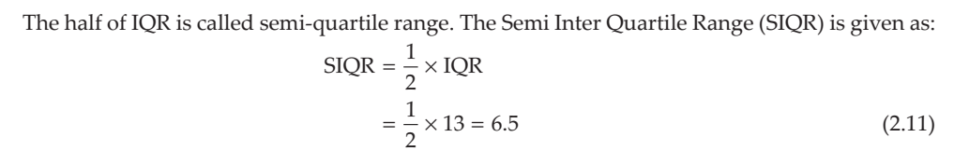

Slide 95
Five-point Summary and Box Plots
The median, quartiles Q1 and Q3, and minimum and maximum written in the order < Minimum, Q1, Median, Q3, Maximum > is known as five-point summary.
Box plots are suitable for continuous variables and a nominal variable.
Box plots can be used to illustrate data distributions and summary of data.
It is the popular way for plotting five number summaries.
A Box plot is also known as a Box and whisker plot.
The box contains bulk of the data. These data are between first and third quartiles. The line inside the box indicates location – mostly median of the data.

Slide 96
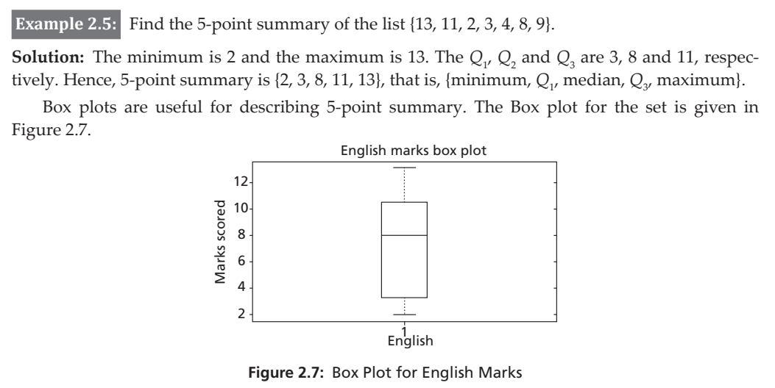

Slide 97
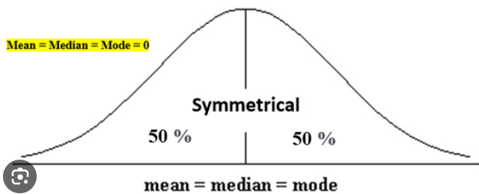
For understanding
Skewness is a measure of symmetry, or more precisely, the lack of symmetry.
A distribution, or data set, is symmetric if it looks the same to the left and right of the center point.
Kurtosis is a measure of whether the data are heavy-tailed or light-tailed relative to a normal distribution.
Example:
Asymmetry exists when the two halves of something don't match or are unequal. The American flag is an example of asymmetry.
What is the relationship between skew and kurtosis?
While skewness focuses on the spread (tails) of normal distribution, kurtosis focuses more on the height.

Slide 98
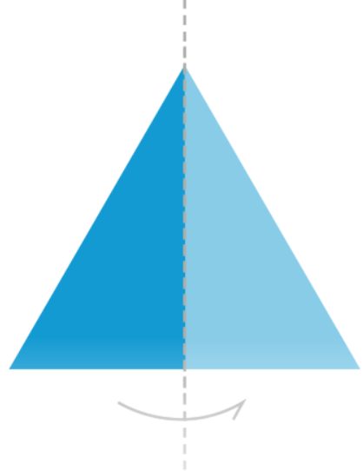
For understanding
What are examples of asymmetrical shapes?
There are many shapes in nature that are asymmetrical, such as rocks, leaves, pine cones, and plants. Letters and numbers can be asymmetrical. Any shape in which the two sides do not match up exactly is asymmetrical.
What is an asymmetrical shape?
An asymmetrical shape is the opposite of a symmetrical shape. If an asymmetrical shape is divided in half, the two sides will not don’t match.
Asymmetry is the opposite of symmetry.
If something has symmetry, it means that the two
halves are exact reflections of each other

Slide 99
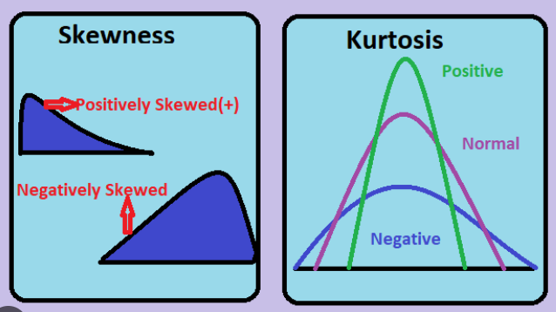
For Understanding : Skewness & Kurtosis
Positive Skewness: In this, the concentration of frequencies is more towards higher values of the variable i.e. the right tail is longer than the left tail.
Negative Skewness: In this, the concentration of frequencies is more towards the lower values of the variable i.e. the left tail is longer than the right tail.

Slide 100
2.5.4 Shape
Skewness and Kurtosis (called moments) indicate the symmetry/asymmetry and peak location of the dataset.
Skewness
The measures of direction and degree of symmetry are called measures of third order.
Ideally, skewness should be zero as in ideal normal distribution.
More often, the given dataset may not have perfect symmetry

Slide 101
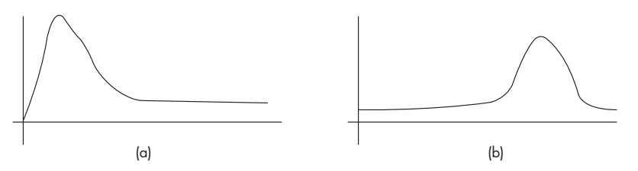
(a) Positive Skewed and (b) Negative Skewed Data
The dataset may also either have very high values or extremely low values.
If the dataset has far higher values, then it is said to be skewed to the right.
On the other hand, if the dataset has far more low values then it is said to be skewed towards left.

Slide 102
The given dataset may have an equal distribution of data.
The implication of this is that if the data is skewed, then there is a greater chance of outliers in the dataset.
This affects the mean and median. Hence, this may affect the performance of the data mining algorithm.
A perfect symmetry means the skewness is zero. In the case of skew, the median is greater than the mean.
In positive skew, the mean is greater than the median.
Generally, for negatively skewed distribution, the median is more than the mean.

Slide 103
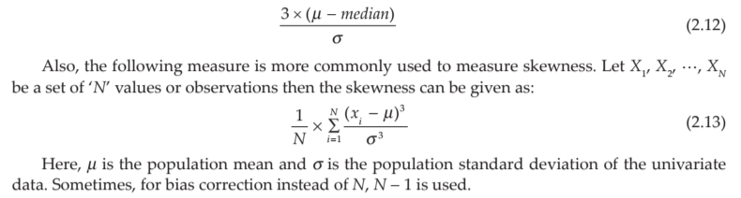
The relationship between skew and the relative size of the mean and median can be summarized by a convenient numerical skew index known as Pearson 2 skewness coefficient.

Slide 104
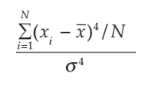
Kurtosis
Kurtosis also indicates the peaks of data. If the data is high peak, then it indicates higher kurtosis and vice versa.
Kurtosis is the measure of whether the data is heavy tailed or light tailed relative to normal distribution. It can be observed that normal distribution has bell-shaped curve with no long tails.
Low kurtosis tends to have light tails. The implication is that there is no outlier data. Let x1, x2, …, xN be a set of ‘N’ values or observations. Then, kurtosis is measured using the formula given below:
It can be observed that N - 1 is used instead of N in the numerator of Eq. (2.14) for bias correction. Here, x and s are the mean and standard deviation of the univariate data, respectively.

Slide 105


Some of the other useful measures for finding the shape of the univariate dataset are mean absolute deviation (MAD) and coefficient of variation (CV).
Mean Absolute Deviation (MAD)
The mean absolute deviation of a dataset is the average distance between each data point and the mean.
MAD is another dispersion measure and is robust to outliers. Normally, the outlier point is detected by computing the deviation from median and by dividing it by MAD. Here,
The sum of the absolute deviations is given as
Therefore, the mean absolute deviation is given as:
Coefficient of Variation
(CV) Coefficient of variation is used to compare datasets with different units. CV is the ratio of standard deviation and mean, and %CV is the percentage of coefficient of variations. The coefficient of variation (CV) is defined as the ratio of the standard deviation to the mean.

Slide 106
2.5.5 Special Univariate Plots
The ideal way to check the shape of the dataset is a stem and leaf plot.
A stem and leaf plot are a display that help us to know the shape and distribution of the data.
In this method, each value is split into a ’stem’ and a ’leaf’. The last digit is usually the leaf and digits to the left of the leaf mostly form the stem.

Slide 107
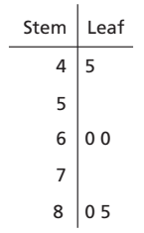
For example, marks 45 are divided into stem 4 and leaf 5 in Figure The stem and leaf plot for the English subject marks, say, {45, 60, 60, 80, 85}
Stem and Leaf Plot for English Marks:

Slide 108
As discussed earlier, the ideal shape of the dataset is a bell-shaped curve. This corresponds to normality.
Most of the statistical tests are designed only for normal distribution of data.
A Q-Q plot can be used to assess the shape of the dataset.
The Q-Q plot is a 2D scatter plot of an univariate data against theoretical normal distribution data or of two datasets - the quartiles of the first and second datasets.

Slide 109
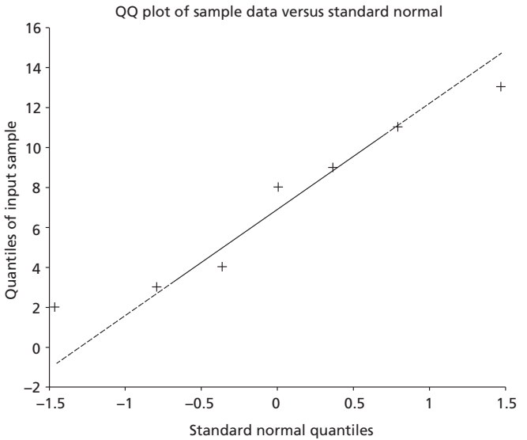
The normal Q-Q plot for marks x = [13 11 2 3 4 8 9] is given below in Figure.
Ideally, the points fall along the reference line (45 Degree) if the data follows normal distribution.
If the deviation is more, then there is greater evidence that the datasets follow some different distribution, that is, other than the normal distribution shape.
In such a case, careful analysis of the statistical investigations should be carried out before interpretation.
This skewness, kurtosis, mean absolute deviation and coefficient of variation help in assessing the univariate data.
Normal Q-Q Plot

Slide 110
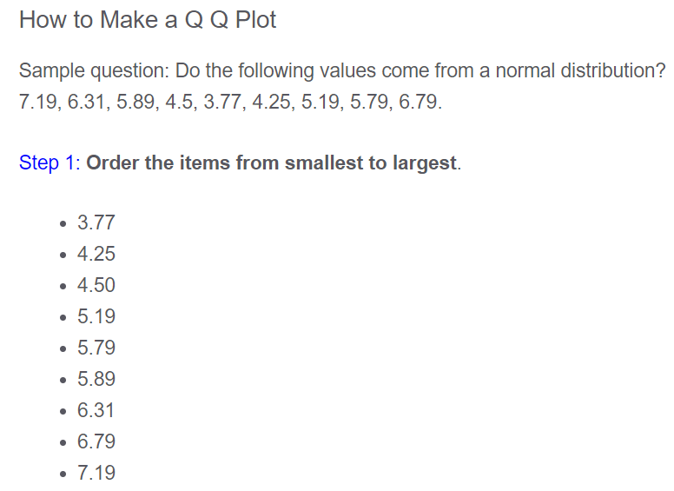
For Understanding

Slide 111
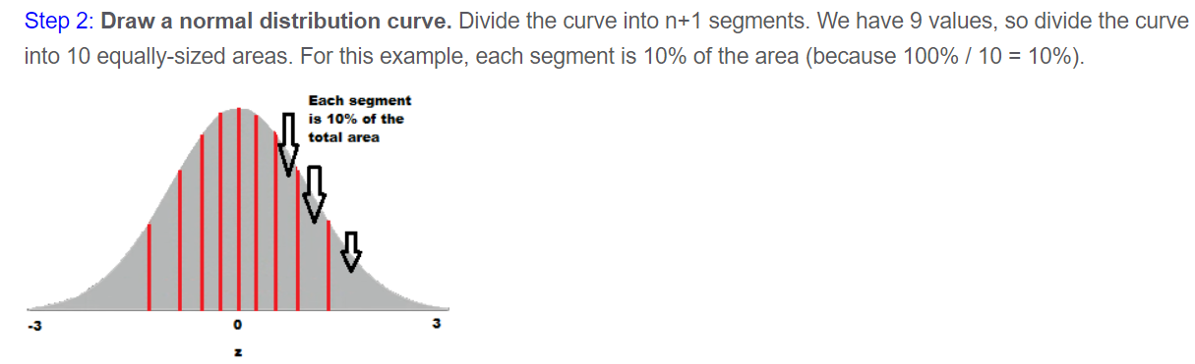
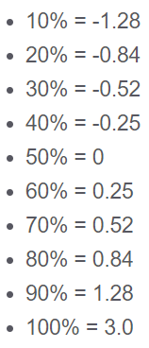
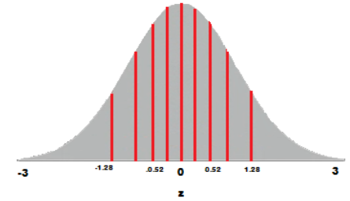
For Understanding
z = (x-μ)/σ

Slide 112
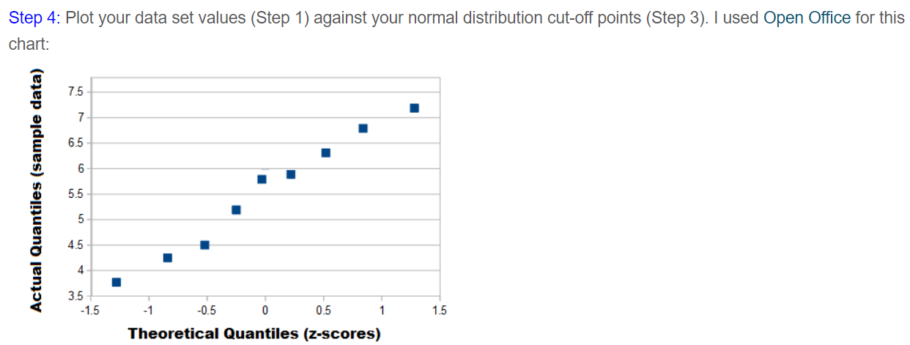
For Understanding

Slide 113
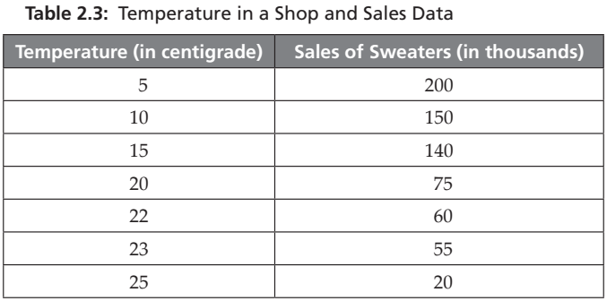
2.6 BIVARIATE DATA AND MULTIVARIATE DATA
Bivariate Data involves two variables.
Bivariate data deals with causes of relationships. The aim is to find relationships among data. Consider the following Table 2.3, with data of the temperature in a shop and sales of sweaters.

Slide 114
Here, the aim of bivariate analysis is to find relationships among variables. The relationships can then be used in comparisons, finding causes, and in further explorations.
To do that, graphical display of the data is necessary. One such graph method is called scatter plot.
Scatter plot is used to visualize bivariate data. It is useful to plot two variables with or without nominal variables, to illustrate the trends, and also to show differences.
It is a plot between explanatory and response variables. It is a 2D graph showing the relationship between two variables.

Slide 115


The scatter plot indicates strength, shape, direction and the presence of Outliers. It is useful in exploratory data before calculating a correlation coefficient or fitting regression curve.
Line graphs are similar to scatter plots. The Line Chart for sales data is shown in Figure
Scatter Plot
Line Chart

Slide 116

2.6.1 Bivariate Statistics
Covariance and Correlation are examples of bivariate statistics.
Covariance is a measure of joint probability of random variables, say X and Y. Generally, random variables are represented in capital letters.
It is defined as covariance(X, Y) or COV(X, Y) and is used to measure the variance between two dimensions.
The formula for finding co-variance for specific x, and y are:

Slide 117

https://www.youtube.com/watch?v=lKV38oxApVA

Slide 118
Correlation
The Pearson correlation coefficient is the most common test for determining any association between two phenomena. It measures the strength and direction of a linear relationship between the x and y variables.
The correlation indicates the relationship between dimensions using its sign. The sign is more important than the actual value.
1. If the value is positive, it indicates that the dimensions increase together. 2. If the value is negative, it indicates that while one-dimension increases, the other dimension decreases.
3. If the value is zero, then it indicates that both the dimensions are independent of each other. If the dimensions are correlated, then it is better to remove one dimension as it is a redundant dimension.

Slide 119



Slide 120

2.7 MULTIVARIATE STATISTICS
In machine learning, almost all datasets are multivariable.
Multivariate data is the analysis of more than two observable variables, and often, thousands of multiple measurements need to be conducted for one or more subjects.
The multivariate data is like bivariate data but may have more than two dependant variables.
Some of the multivariate analysis are regression analysis, principal component analysis, and path analysis.
The mean of multivariate data is a mean vector and the mean of the above three attributes is given as (2, 7.5, 1.33).
The variance of multivariate data becomes the covariance matrix.
The mean vector is called centroid and variance is called
dispersion matrix.

Slide 121



For Understanding - Heatmap
Correlation is the statistical measure that defines to which extent two variables are linearly related to each other.
We use correlation to find the relation between columns of the dataset

Slide 122

For Understanding

Slide 123

For Understanding
Example:2 The amount of coffee that individuals consume and their IQ level has a correlation of zero.

Slide 124
For Understanding
Use Cases For Heatmaps
As we know the Heatmap is just a colored representation of a matrix. However, heatmap has a very large use case. We can use heatmaps for the following purpose.
It is used to see the correlation between columns of a dataset where we can use a darker color for columns having a high correlation.
We can also use heatmaps for plotting various time series and finance-related data where the Y-axis will be the month and X-axis will be the year and the element of the heatmap will be our data.

Slide 125
Heatmap
Heatmap is a graphical representation of 2D matrix. It takes a matrix as input and colours it.
The darker colours indicate very large values and lighter colours indicate smaller values.
The advantage of this method is that humans perceive colours well. So, by colour shaping, larger values can be perceived well.
For example, in vehicle traffic data, heavy traffic regions can be differentiated from low traffic regions through heatmap.

Slide 126

In Figure, patient data highlighting weight and health status is plotted. Here, X-axis is weights and Y-axis is patient counts.
The dark colour regions highlight patients’ weights vs patient counts in health status.

Slide 127
Pairplot
Pairplot or scatter matrix is a data visual technique for multivariate data.
A scatter matrix consists of several pair-wise scatter plots of variables of the multivariate data.
All the results are presented in a matrix format.
By visual examination of the chart, one can easily find relationships among the variables such as correlation between the variables.

Slide 128

A random matrix of three columns is chosen and the relationships of the columns is plotted as a pairplot (or scattermatrix)

Slide 129
For Understanding:
Gaussian elimination method is known as the row reduction algorithm for solving linear equations systems.
It consists of a sequence of operations performed on the corresponding matrix of coefficients.
Gaussian elimination aims to transform a system of linear equations into an upper-triangular matrix in order to solve the unknowns and derive a solution.
Gauss elimination method is used to find the value of variables.

Slide 130
ESSENTIAL MATHEMATICS FOR MULTIVARIATE DATA
Machine learning involves many mathematical concepts from the domain of Linear algebra, Statistics, Probability and Information theory.
2.8.1 Linear Systems and Gaussian Elimination for Multivariate Data
'Linear Algebra' is a branch of mathematics that is central for many scientific applications and other mathematical subjects. While all branches of mathematics are crucial for machine learning, linear algebra plays a major large role as it is the mathematics of data. Linear algebra deals with linear equations, vectors, matrices, vector spaces and transformations.

Slide 131


Slide 132


Slide 133

https://www.youtube.com/watch?v=2j5Ic2V7wq4

Slide 134


Slide 135




Slide 136



Slide 137
2.8.3 Machine Learning and Importance of Probability and Statistics
Machine learning is linked with statistics and probability. Like linear algebra, statistics is the heart of machine learning.
The importance of statistics needs to be stressed as without statistics; analysis of data is difficult. Probability is especially important for machine learning.
Any data can be assumed to be generated by a probability distribution.
Machine learning datasets have multiple data that are generated by multiple distributions.

Slide 138
Probability Distributions
A probability distribution of a variable, say X, summarizes the probability associated with X’s events.
Distribution is a parameterized mathematical function.
In other words, distribution is a function that describes the relationship between the observations in a sample space.
Consider a set of data. The data is said to follow a distribution if it obeys a mathematical function that characterizes that distribution.
The function can be used to calculate the probability of individual observations. Probability distributions are of two types:
1. Discrete probability distribution
2. Continuous probability distribution

Slide 139
The relationships between the events for a continuous random variable and their probabilities is called a continuous probability distribution.
It is summarized as Probability Density Function (PDF).
PDF calculates the probability of observing an instance. The plot of PDF shows the shape of the distribution.
Cumulative Distributive Function (CDF) computes the probability of an observation ≤ value.

Slide 140
Both PDF and CDF are continuous values.
The discrete equivalent of PDF in discrete distribution is called Probability Mass Function (PMF).
The probability of an event cannot be detected directly.
It should be computed as the area under the curve for a small interval around the specific outcome.
This is defined as CDF. Let us discuss some of the distributions that are encountered in machine learning.
Continuous Probability Distributions Normal, Rectangular, and Exponential distributions fall under this category.

Slide 141

1. Normal Distribution – Normal distribution is a continuous probability distribution.
This is also known as gaussian distribution or bell-shaped curve distribution. It is the most common distribution function.
The shape of this distribution is a typical bell-shaped curve.
In normal distribution, data tends to be around a central value with no bias on left or right.
The heights of the students, the blood pressure of a population, and marks scored in a class can be approximated using the normal distribution.

Slide 142



Slide 143


Slide 144


Slide 145



